Slide 1
Neural Language Models
Slides are adopted from Advanced NLP course at UMass.

Slide 2
Intro
Language models assign a probability to a piece of text.
Why would we ever want to do this?
  Translation:
  P(i flew to the movies) <<<<< P(i went to the movies)
  Speech recognition:
    P(i saw a van) >>>>> P(eyes awe of an)
Notes:
Bengio 2003

Slide 3
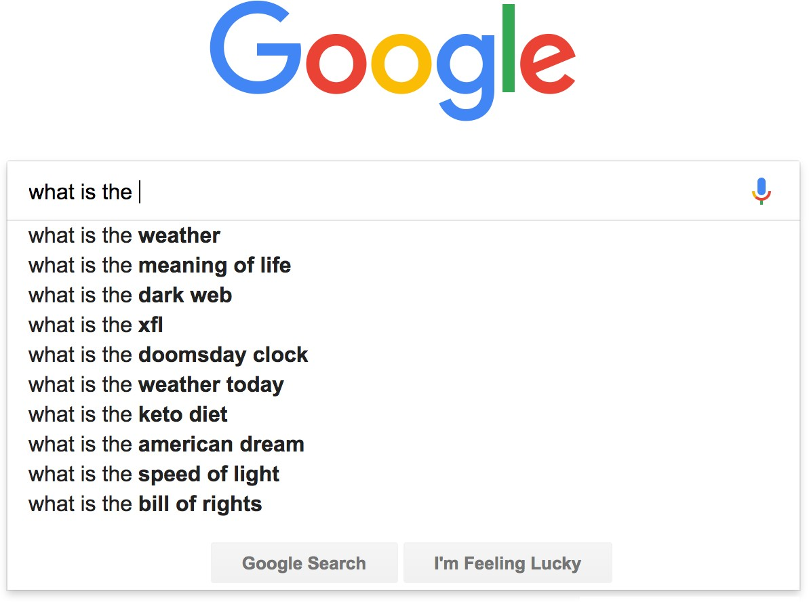
You use Language Models every day!
Notes:
Smartphone keyboards

Slide 4

Probabilistic Language Modeling
Goal: compute the probability of a sentence or sequence of words:
  $$P(W) = P(w1,w2,w3,w4,w5,…,wn)$$
Related task: probability of an upcoming word:
  $$P(w5|w1,w2,w3,w4)$$
A model that computes either of these:
  $P(W)$ or $P(w_{n}|w1,w2,…,w_{n−1})$ is called a language model or LM.

Slide 5
How to compute P(W)
How to compute this joint probability:
  P(its, water, is, so, transparent, that)
Intuition: let’s rely on the Chain Rule of Probability

Slide 6
Reminder: The Chain Rule
Recall the definition of conditional probabilities
$P(B|A) = P(A,B)/P(A)$ Rewriting: $P(A,B)=P(A)P(B|A)$
More variables:
$$P(A,B,C,D) = P(A)P(B|A)P(C|A,B)P(D|A,B,C)$$
The Chain Rule in General
$$P(x1,x2,x3,…,xn) = P(x1)P(x2|x1)P(x3|x1,x2)…P(x_{n}|x1,…,x_{n−1})$$

Slide 7
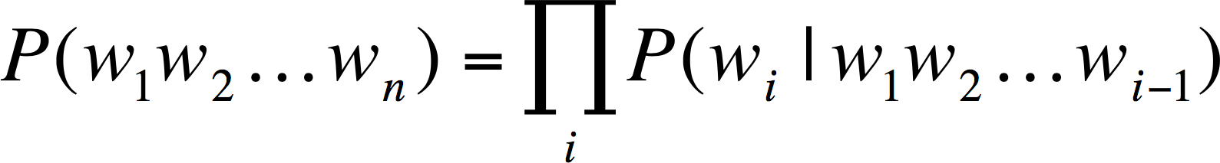
Chain Rule for computing joint probability
The Chain Rule applied to compute joint probability of words in sentence
prefix
P(“its water is so transparent”) = P(its) × P(water|its) × P(is|its water)
× P(so|its water is) × P(transparent|its water is so)

Slide 8

How to estimate these probabilities
Could we just count and divide?
$$P(the| its water is so transparent that)=\frac{\text{Count} \text{(}\text{its} \text{water} \text{is} \text{so} \text{transparent} \text{that} \text{the}\text{) }}{\text{Count} \text{(}\text{its} \text{water} \text{is} \text{so} \text{transparent} \text{that}\text{) }}$$
Notes:
Complexity

Slide 9
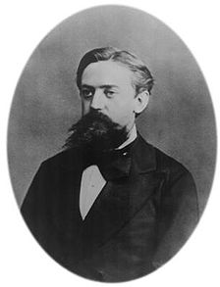
Markov Assumption
Simplifying assumption:
P(the | its water is so transparent that) ≈ P(the | that)
or maybe
P(the | its water is so transparent that) ≈ P(the | transparent that)
Andrei Markov (1856~1922)

Slide 10
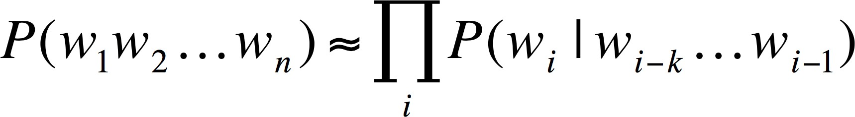
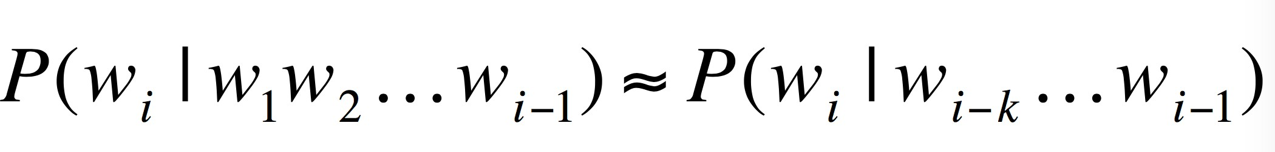
Markov Assumption
In other words, we approximate each component in the product:

Slide 11
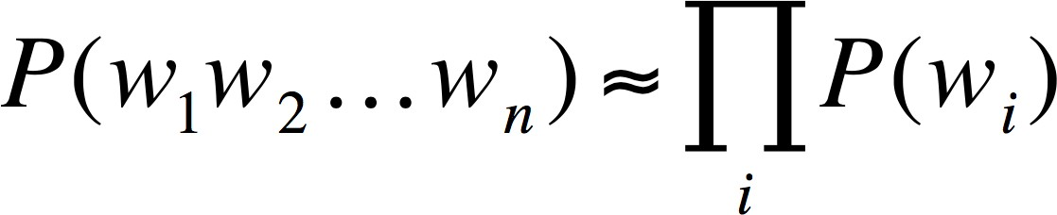
Simplest Case: Unigram Model

Slide 12
Simplest case: Unigram model
Some automatically generated sentences from a unigram model:
fifth, an, of, futures, the, an, incorporated, a, a, the, inflation, most, dollars, quarter, in, is, mass thrift, did, eighty, said, hard, 'm, july, bullish that, or, limited, the
How can we generate text from a language model?

Slide 13
Decoding from an LM
Prefix: “students opened their”
books
laptops
a zoo
Probability distribution over next word

Slide 14
Approximating Shakespeare
1
gram
–To him swallowed confess hear both. Which. Of save on trail for are ay device and rote life have
–Hill he late speaks; or! a more to leg less first you enter
–Why dost stand forth thy canopy, forsooth; he is this palpable hit the King Henry. Live king. Follow.
–What means, sir. I confess she? then all sorts, he is trim, captain.
–Fly, and will rid me these news of price. Therefore the sadness of parting, as they say, ’tis done.
–This shall forbid it should be branded, if renown made it empty.
–King Henry. What! I will go seek the traitor Gloucester. Exeunt some of the watch. A great banquet serv’d in;
–It cannot be but so.
2
gram
3
gram
4
gram

Slide 15
N-gram models
We can extend to trigrams, 4-grams, 5-grams
In general this is an insufficient model of language because language has long-distance dependencies:
“The computer which I had just put into the machine room on the fifth floor crashed.”

Slide 16

Estimating Bigram Probabilities
The Maximum Likelihood Estimate (MLE)
  Relative frequency based on the empirical counts on a training set
  $$P\left(w_{i} | w_{i−1}\right)=\frac{count\left(w_{i−1},w_{i}\right)}{count\left(w_{i}−1\right)}=\frac{c\left(w_{i−1},w_{i}\right)}{c\left(w_{i}−1\right)}$$
c = count

Slide 17

An Example
$P\left(w_{i} | w_{i−1}\right)=\frac{count\left(w_{i−1},w_{i}\right)}{count\left(w_{i}−1\right)}=\frac{c\left(w_{i−1},w_{i}\right)}{c\left(w_{i}−1\right)}$
MLE
<s> I am Sam </s>
<s> Sam I am </s>
<s> I do not like green eggs and ham </s>
Important terminology: a word type is a unique word in our vocabulary, while a token is an occurrence of a word type in a dataset.
Notes:
بیندیش وآن گه بر آور نفس
و زآن پیش بس کن که گویند بس

Slide 18
Demo
https://books.google.com/ngrams/

Slide 19
Evaluation: How good is our model?
Does our language model prefer good sentences to bad ones?
  Assign higher probability to “real” or “frequently observed” sentences
    Than “ungrammatical” or “rarely observed” sentences?
We train parameters of our model on a training set.
We test the model’s performance on data we haven’t seen.
  A test set is an unseen dataset that is different from our training set, totally unused.
  An evaluation metric tells us how well our model does on the test set.

Slide 20
Evaluation: How good is our model?
The goal isn’t to pound out fake sentences!
  Obviously, generated sentences get “better” as we increase the model order
  More precisely: using maximum likelihood estimators, higher order is always better likelihood on training set, but not test set

Slide 21

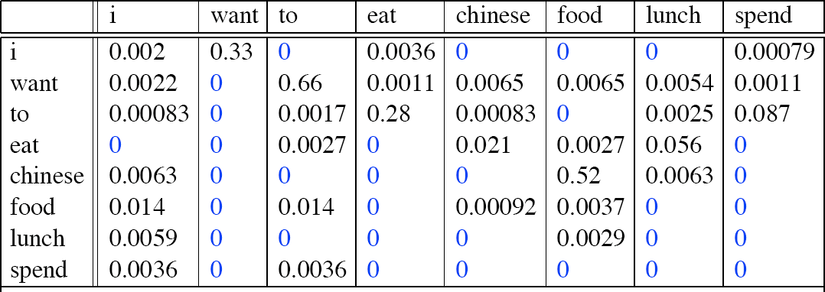

Example
Use a bunch of New York Times articles to build a bigram probability table
train
evaluate
A good language model should assign a high probability to heldout text!
Now I’m going to evaluate the probability of some heldout
data using our bigram table

Slide 22
Training on the test set
We can’t allow test sentences into the training set
We will assign it an artificially high probability when we set it in the test set
“Training on the test set”
Bad science!
This advice is generally applicable to any downstream task! Do NOT do this in your final projects unless you want to lose a lot of points :)

Slide 23
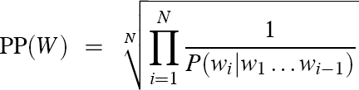
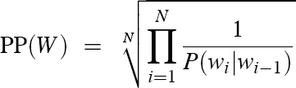
Perplexity
The best language model is one that best predicts an unseen test set
  Gives the highest P(sentence)
  Perplexity is the inverse probability of the test set, normalized by the number of words:
−
1
N
PP(W ) = P(w₁w₂...w_{N} )
_{= N} 1
P(w₁w₂...w_{N} )
Chain rule:
For bigrams:
Minimizing perplexity is the same as maximizing probability

Slide 24
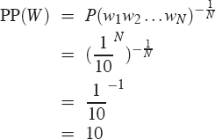
Perplexity as branching factor
Let’s suppose a sentence consisting of random digits
What is the perplexity of this sentence according to a model that assign P=1/10 to each digit?

Slide 25

In practice, we use log probs
$$PP\left(W\right)=\exp\left(−\frac{1}{N}Σ_{i}^{N}\log{P\left(w_{i}|w_{<i}\right)}\right)$$
Perplexity is the token-level negative log-likelihood

Slide 26
Lower Perplexity = Better Model
Training 38 million words, test 1.5 million words, Wall Street Journal
N-gram Order | Unigram | Bigram | Trigram
Perplexity | 962 | 170 | 109

Slide 27
Shakespeare as corpus
N=884,647 tokens, V=29,066
Shakespeare produced 300,000 bigram types out of V²= 844 million possible bigrams.
  So 99.96% of the possible bigrams were never seen (have zero entries in the table)

Slide 28
Zeros
Training set:
… denied the allegations
… denied the reports
… denied the claims
… denied the request
Test set
… denied the offer
… denied the loan
P(“offer” | denied the) = 0

Slide 29
The intuition of smoothing
When we have sparse statistics:
  P(w | denied the) 3 allegations
  2 reports
  1 claims
  1 request
  7 total
Steal probability mass to generalize better
  P(w | denied the)
  2.5 allegations
  1.5 reports
  0.5 claims
  0.5 request
  2 other
  7 total
allegations
reports
attack
man outcome
claims
request
…
allegations
allegations
outcome
reports
attack
man
…
claims
request

Slide 30
Problems with n-gram models
$$P(w_{j}|students opened their)=\frac{count\left(students opened their \right|{ w}_{j})}{count(students opened their)}$$
Sparsity Problem 1
Problem: What if “students opened their $w_{j}$” never occurred in data? Then $w_{j}$ has probability 0!
(Partial) Solution: Add small $δ$
to count for every $w_{j}∈V$. This is called smoothing.

Slide 31
Problems with n-gram models
$$P(w_{j}|students opened their)=\frac{count\left(students opened their \right|{ w}_{j})}{count(students opened their)}$$
Storage: Need to store count for all possible n-grams. So model size is O(exp(n)).
Increasing n makes model size huge!

Slide 32
Another issue
We treat all words / prefixes independently of each other!
  students opened their _______
  pupils opened their _______
  scholars opened their _______
  undergraduates opened their _______
  students turned the pages of their _______
  students attentively perused their _______
  …
Shouldn’t we share information across these semantically-similar prefixes?

Slide 33
One-hot Vectors
n-gram models rely on the “bag-of-words” assumption
represent each word/n-gram as a vector of zeros with a single 1 identifying its index in the vocabulary
movie = <0, 0, 0, 0, 1, 0>
film = <0, 0, 0, 0, 0, 1>
vocabulary
i
hate
love
what are the issues of representing a word this way?
the
movie
film

Slide 34
All words are equally (dis)similar!
movie = <0, 0, 0, 0, 1, 0>
film = <0, 0, 0, 0, 0, 1>
dot product is zero!
these vectors are orthogonal
What we want is a representation space in which words, phrases, sentences etc. that are semantically similar also have similar representations!

Slide 35
Enter neural networks!
Students opened their
This lecture: the forward pass, or how we compute a prediction of the next word given an existing neural language model
Next lecture: the backward pass, or how we train a neural language model on a training dataset using the backpropagation algorithm
neural language model
books
Notes:
Output: Distribution on vocab

Slide 36
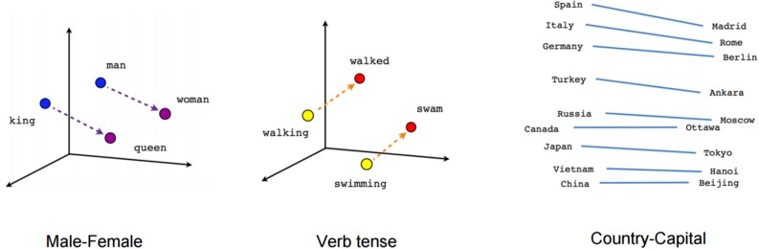
Words as basic building blocks
Represent words with low-dimensional vectors called embeddings (Mikolov et al., NIPS 2013)
king = [0.23, 1.3, -0.3, 0.43]

Slide 37



Composing embeddings
Neural networks compose word embeddings into vectors for phrases, sentences, and documents.
neural
students opened
their
network (
) =

Slide 38
Next word prediction
Predict the next word from composed prefix representation:
predict “books”
neural
students opened
their
Softmax layer:
convert a vector representation into a probability distribution over the entire vocabulary
network (
) =

Slide 39

P(w_{i} | vector for "students opened their")
books
laptops
Probability distribution
over the entire vocabulary
a
zoo
Low-dimensional representation of “students opened their”

Slide 40
Let’s say our output vocabulary consists of just four words: “books”, “houses”, “lamps”, and “stamps”.
books
houses
lamps
stamps
<0.6, 0.2, 0.1, 0.1>
We want to get a probability distribution over these four words
Low-dimensional representation of “students opened their”

Slide 41

$$x =\left[\begin{matrix}−2.3 & 0.9 & 5.4\end{matrix}\right]$$
Here’s an example 3-d prefix vector

Slide 42
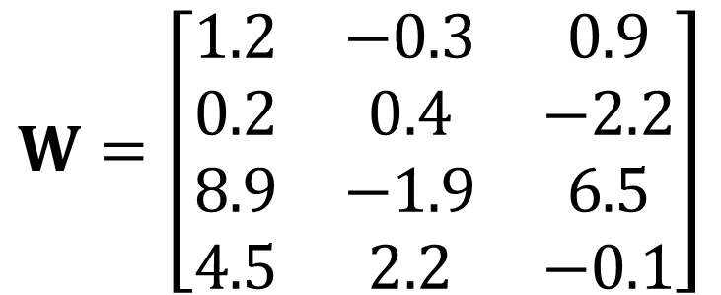

W is a weight matrix. It contains parameters that we can update to control the final probability distribution of the next word
$$W=\left[\begin{matrix}1.2 & −0.3 & 0.9 \\ 0.2 & 0.4 & −2.2 \\ 8.9 & −1.9 & 6.5 \\ 4.5 & 2.2 & −0.1\end{matrix}\right]$$
$$x =\left[\begin{matrix}−2.3 & 0.9 & 5.4\end{matrix}\right]$$
Here’s an example 3-d prefix vector

Slide 43
W is a weight matrix. It contains parameters that we can update to control the final probability distribution of the next word
$$W=\left[\begin{matrix}1.2 & −0.3 & 0.9 \\ 0.2 & 0.4 & −2.2 \\ 8.9 & −1.9 & 6.5 \\ 4.5 & 2.2 & −0.1\end{matrix}\right]$$
books
first, we’ll project our 3-d prefix representation to 4-d with a matrix-vector product
houses
lamps
stamps
$$x =\left[\begin{matrix}−2.3 & 0.9 & 5.4\end{matrix}\right]$$
Here’s an example 3-d prefix vector

Slide 44
$$W=\left[\begin{matrix}1.2 & −0.3 & 0.9 \\ 0.2 & 0.4 & −2.2 \\ 8.9 & −1.9 & 6.5 \\ 4.5 & 2.2 & −0.1\end{matrix}\right]$$
books
houses
lamps
stamps
intuition: each dimension of x corresponds to a feature of the prefix
$$x =\left[\begin{matrix}−2.3 & 0.9 & 5.4\end{matrix}\right]$$

Slide 45
intuition: each row of W contains feature weights for a corresponding word in the vocabulary
$$W=\left[\begin{matrix}1.2 & −0.3 & 0.9 \\ 0.2 & 0.4 & −2.2 \\ 8.9 & −1.9 & 6.5 \\ 4.5 & 2.2 & −0.1\end{matrix}\right]$$
books
houses
lamps
stamps
intuition: each dimension of x corresponds to a feature of the prefix
$$x =\left[\begin{matrix}−2.3 & 0.9 & 5.4\end{matrix}\right]$$

Slide 46
intuition: each row of W contains feature weights for a corresponding word in the vocabulary
$$W=\left[\begin{matrix}1.2 & −0.3 & 0.9 \\ 0.2 & 0.4 & −2.2 \\ 8.9 & −1.9 & 6.5 \\ 4.5 & 2.2 & −0.1\end{matrix}\right]$$
books
houses
lamps
stamps
intuition: each dimension of x corresponds to a feature of the prefix
$$x =\left[\begin{matrix}−2.3 & 0.9 & 5.4\end{matrix}\right]$$

Slide 47
CAUTION: we can’t easily interpret these features! For example, the second dimension of x likely does not correspond to any linguistic property
intuition: each row of W contains feature weights for a corresponding word in the vocabulary
$$W=\left[\begin{matrix}1.2 & −0.3 & 0.9 \\ 0.2 & 0.4 & −2.2 \\ 8.9 & −1.9 & 6.5 \\ 4.5 & 2.2 & −0.1\end{matrix}\right]$$
books
houses
lamps
stamps
intuition: each dimension of x corresponds to a feature of the prefix
$$x =\left[\begin{matrix}−2.3 & 0.9 & 5.4\end{matrix}\right]$$

Slide 48
How did we compute this? It’s just the dot product of each row of W with x!
$$Wx T=\left[\begin{matrix}1.8 & −11.9 & 12.9 & −8.9\end{matrix}\right]$$
$$W=\left[\begin{matrix}1.2 & −0.3 & 0.9 \\ 0.2 & 0.4 & −2.2 \\ 8.9 & −1.9 & 6.5 \\ 4.5 & 2.2 & −0.1\end{matrix}\right]$$
books
houses
lamps
stamps
$$x =\left[\begin{matrix}−2.3 & 0.9 & 5.4\end{matrix}\right]$$

Slide 49
How did we compute this? It’s just the dot product of each row of W with x!
$$Wx T=\left[\begin{matrix}1.8 & −11.9 & 12.9 & −8.9\end{matrix}\right]$$
$$W=\left[\begin{matrix}1.2 & −0.3 & 0.9 \\ 0.2 & 0.4 & −2.2 \\ 8.9 & −1.9 & 6.5 \\ 4.5 & 2.2 & −0.1\end{matrix}\right]$$
books
houses
lamps
stamps
$$x =\left[\begin{matrix}−2.3 & 0.9 & 5.4\end{matrix}\right]$$

Slide 50
How did we compute this? Just the dot product of each row of W with x!
$$Wx T=\left[\begin{matrix}1.8 & −11.9 & 12.9 & −8.9\end{matrix}\right]$$
books
1.2 * -2.3 + -0.3 * 0.9 + 0.9 * 5.4
$$W=\left[\begin{matrix}1.2 & −0.3 & 0.9 \\ 0.2 & 0.4 & −2.2 \\ 8.9 & −1.9 & 6.5 \\ 4.5 & 2.2 & −0.1\end{matrix}\right]$$
houses
lamps
stamps
$$x =\left[\begin{matrix}−2.3 & 0.9 & 5.4\end{matrix}\right]$$

Slide 51
Okay, so how do we go from this 4-d vector to a probability distribution?
$$Wx T=\left[\begin{matrix}1.8 & −11.9 & 12.9 & −8.9\end{matrix}\right]$$

Slide 52
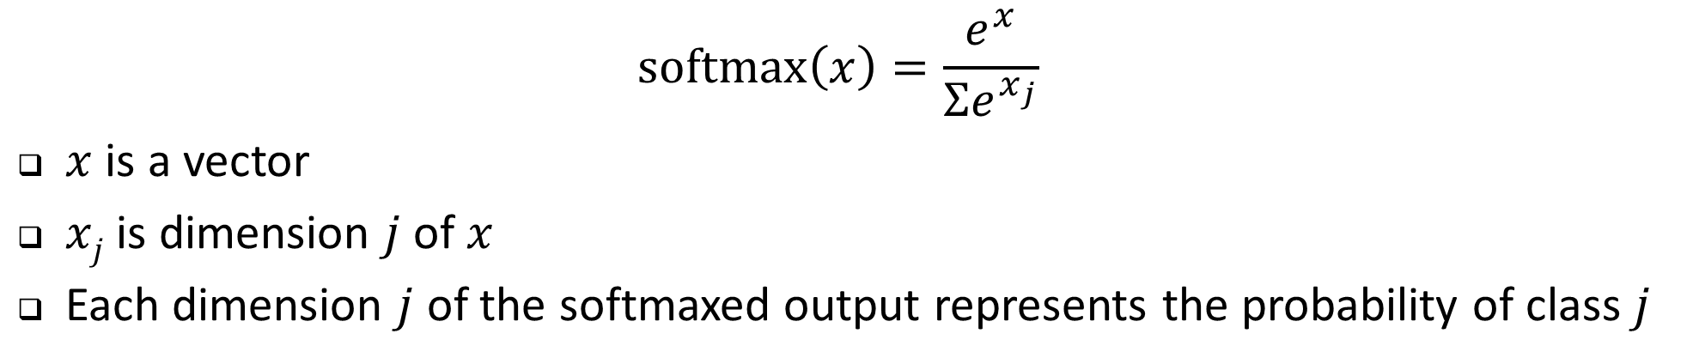
We’ll use the softmax function!
$$softmax\left(x\right)=\frac{e^{x}}{Σe^{x_{j}}}$$
$x$ is a vector
$xj$ is dimension $j$ of $x$
Each dimension $j$ of the softmaxed output represents the probability of class $j$
Wx = <1.8, -1.9, 2.9, -0.9>
softmax(Wx) = <0.24, 0.006, 0.73, 0.02>
books
houses
lamps
stamps
We’ll see the softmax function over and over again this semester, so be sure to understand it!

Slide 53
So to sum up…
Given a d-dimensional vector representation x of a prefix, we do the following to predict the next word:
  Project it to a V-dimensional vector using a matrix-vector product (a.k.a. a “linear layer”, or a “feedforward layer”), where V is the size of the vocabulary.
  Apply the softmax function to transform the resulting vector into a probability distribution.

Slide 54
Now that we know how to predict “books”, let’s focus on how to compute the prefix representation x in the first place!
predict “books”
neural
students opened
their
network (
) =

Slide 55
Composition functions
Input: sequence of word embeddings corresponding to the tokens of a given prefix
Output: single vector
Composition functions:
  Element-wise functions
    e.g., just sum up all of the word embeddings!
  Concatenation
  Feed-forward neural networks
  Convolutional neural networks
  Recurrent neural networks
  Transformers (our focus this semester)

Slide 56
Let’s look first at concatenation, an easy to understand but limited composition function

Slide 57
A fixed-window neural Language Model
as the proctor started
the clock
the students opened
fixed window
their
discard

Slide 58

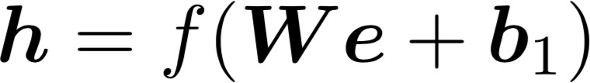
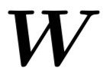


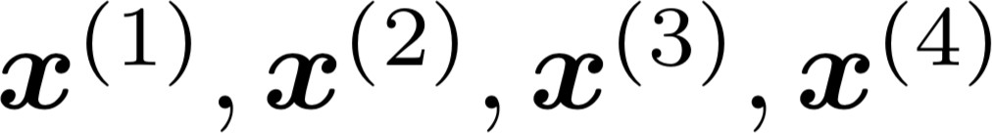
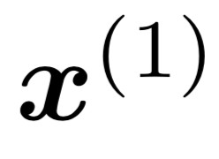
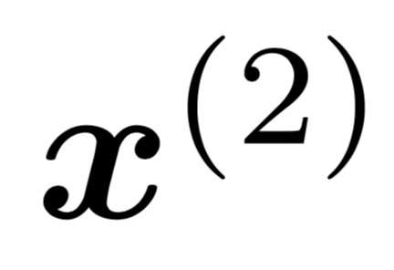
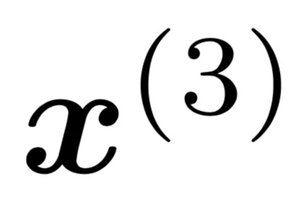
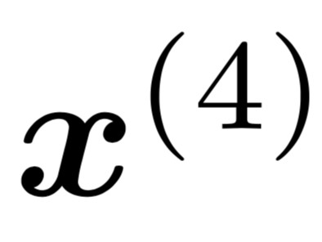
A fixed-window neural Language Model
books
laptops
output distribution
ŷ = softmax(W₂h + b₂)
a zoo
W₂
hidden layer
h = f(W₁c + b₁)
W₁
concatenated word embeddings
x = [c₁; c₂; c₃; c₄]
words / one-hot vectors
the students
opened
their
c₁, c₂, c₃, c₄
c₁
c₂
c₃
c₄

Slide 59
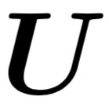
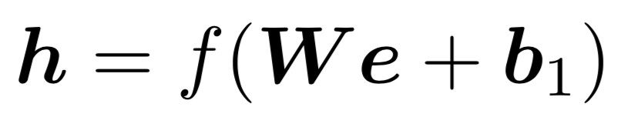



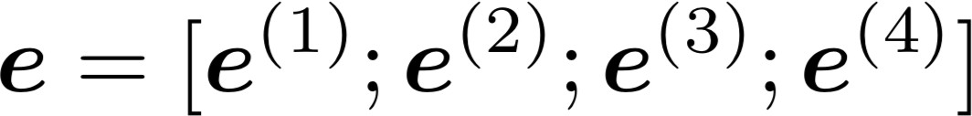
A fixed-window neural Language Model
books
laptops
output distribution
ŷ = softmax(W₂h + b₂)
a zoo
W₂
hidden layer
h = f(W₁x)
W
1
concatenated word embeddings
x = [c₁; c₂; c₃; c₄]
words / one-hot vectors
the students
opened
their
c₁, c₂, c₃, c₄
c₁
c₂
c₃
c₄

Slide 60
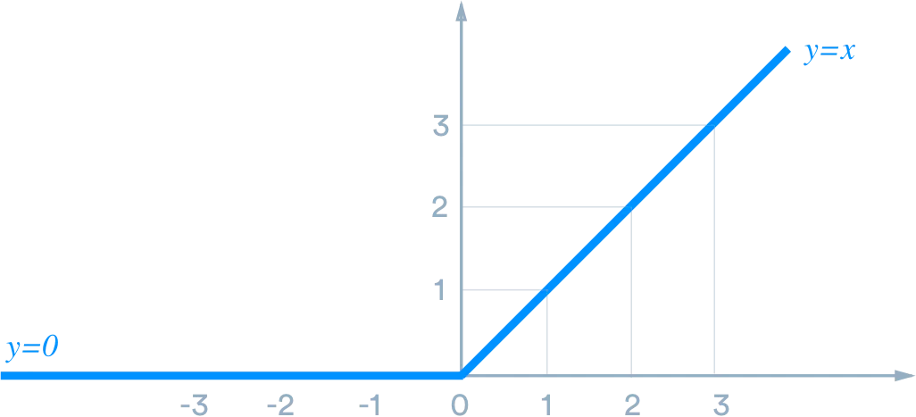
A fixed-window neural Language Model
f is a nonlinearity, or an element-wise nonlinear function.
The most commonly-used choice today is the rectified linear unit (ReLu), which is just ReLu(x) = max(0, x).
Other choices include tanh and sigmoid.
books
laptops
output distribution
ŷ = softmax(W₂h + b₂)
a zoo
W₂
hidden layer
h = f(W₁x)
W
1
concatenated word embeddings
x = [c₁; c₂; c₃; c₄]
words / one-hot vectors
the students
opened
their
c₁, c₂, c₃, c₄
c₁
c₂
c₃
c₄

Slide 61
A fixed-window neural Language Model
books
laptops
output distribution
ŷ = softmax(W₂h)
a
zoo
W₂
hidden layer
h = f(W₁x)
W
1
concatenated word embeddings
x = [c₁; c₂; c₃; c₄]
words / one-hot vectors
the students
opened
their
c₁, c₂, c₃, c₄
c₁
c₂
c₃
c₄

Slide 62
how does this compare to a normal n-gram model?
books
laptops
Improvements over n-gram LM:
No sparsity problem
Model size is O(n) not O(exp(n))
Remaining problems:
Fixed window is too small
Enlarging window enlarges W
Window can never be large enough!
Each uses different rows of W. We don’t share weights across the window.
a
zoo
W₂
W
1
the students
opened
their
c
c
c
c
1
2
3
4
Notes:
Sparsity issue: As the value of n increases, the number of unique n-grams in the training data also increases exponentially, leading to many unseen or rare n-grams. This sparsity issue can lead to inaccurate estimates of probabilities for unseen or rare sequences, affecting the model's performance.

Slide 63
Recurrent Neural Networks!

Slide 64
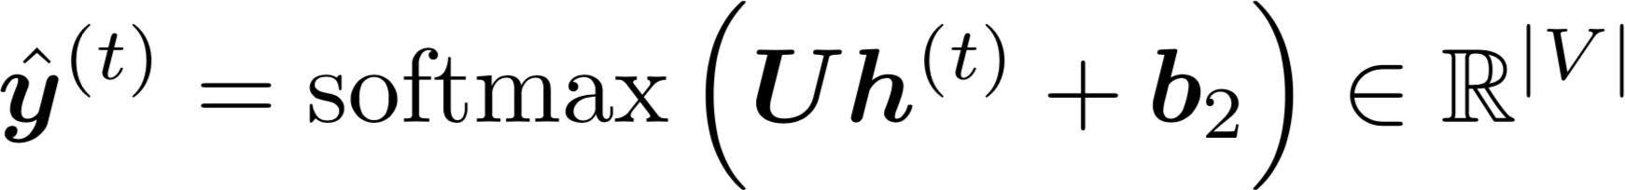

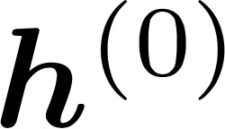
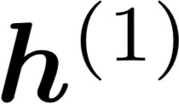
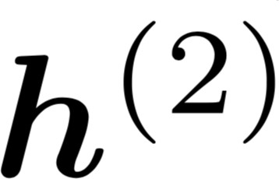
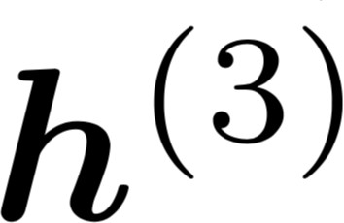
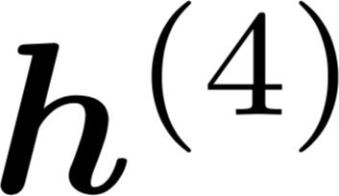


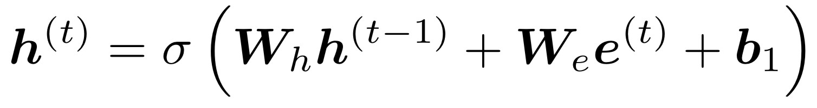

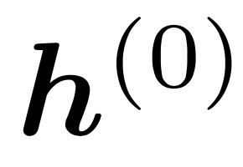




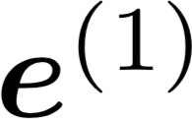
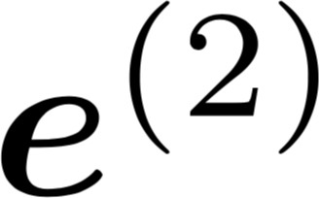

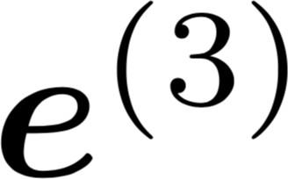
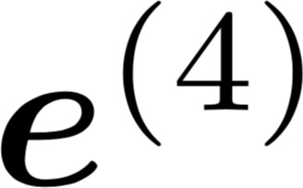
An RNN Language Model
books
laptops
output distribution
ŷ = softmax(W₂h^{(t)})
a
zoo
W₂
hidden states
h^{(t)} = f(W_{h}h^{(t−1)} + W_{e}c_{t})
h⁽⁰⁾ is initial hidden state!
word embeddings
c₁, c₂, c₃, c₄
is the initial hidden state
the students
c₁ c₂
opened their
c₃ c₄

Slide 65
Why is this good?
books
RNN Advantages:
  Can process any length input
  Model size doesn’t increase for longer input
  Computation for step t can (in theory) use information from many steps back
  Weights are shared across timesteps -> representations are shared
RNN Disadvantages:
  Recurrent computation is slow
  In practice, difficult to access information from many steps back
laptops
a
zoo
W₂
the
1
students
c
opened their
c c
c
2
3
4

